Slide 1


CSCE 606
TEXAS A&M SPRING 2023
PayFast: The Virtual Wallet
A Ruby on Rails Application
Chunkai Fu, Jackson Sanders, Keerthana Polkampally, Sambhav Khurana, Swetha Reddy

Slide 2
Agenda
1
Why Virtual Wallet?
2
Application Walkthrough
3
Challenges and lessons

Slide 3
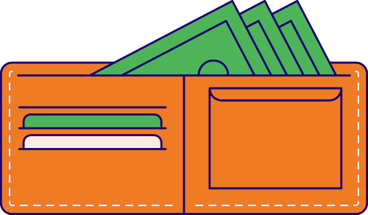
Why PayFast?

Slide 4
Why PayFast?
A teleological examination of the wallet...

Slide 5

Why PayFast?
A teleological examination of the wallet...
Cash
Cards
Trinkets

Slide 6

Why PayFast?
A teleological examination of the wallet...
Cash
Cards
Trinkets

Slide 7
Why PayFast?
A teleological examination of the wallet...
Cash
Cards
Direct transactions
Small purchases
Deposit
Online shopping
Stores
Restaurants
Travel

Slide 8
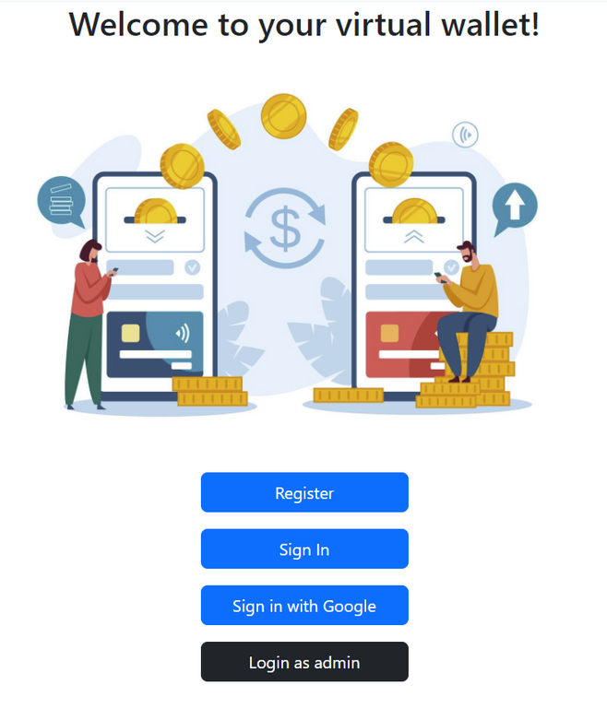

Our Mission
At Virtual Wallet, our mission is to help people take control of their finances by providing a secure and easy-to-use platform for managing their money online.

Slide 9

Our Mission
At Virtual Wallet, our mission is to help people take control of their finances by providing a secure and easy-to-use platform for managing their money online.

Slide 10

TO EXTRA FEATURES
Let's visualize & experience the flow of the site
5.1
2
Add more cards
KYC Submission
1.1
Sign Up
4
Create a wallet & add a card
Wait for approval
5.2
Admin approves KYC
Add a balance
1.2
Login
Admin login
Transact with other users
6
3

Slide 11
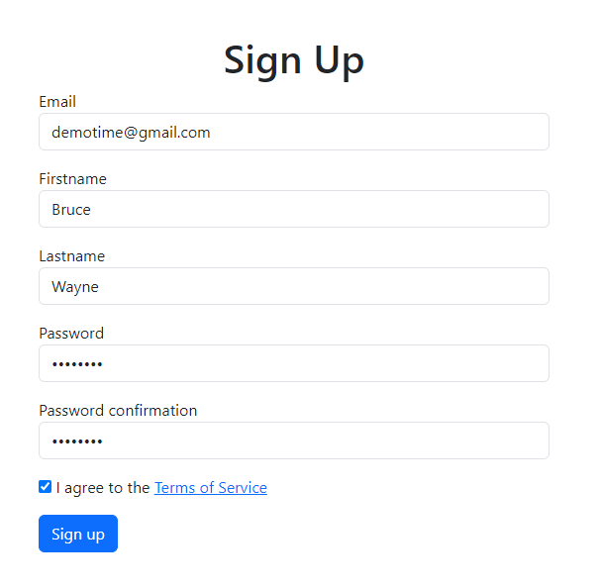
Sign Up
BACK TO FLOWCHART

Slide 12
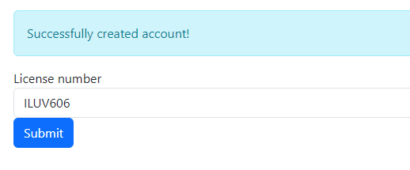
KYC Submission
BACK TO FLOWCHART

Slide 13
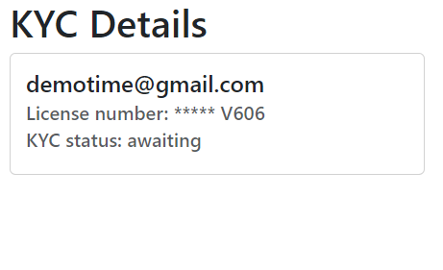
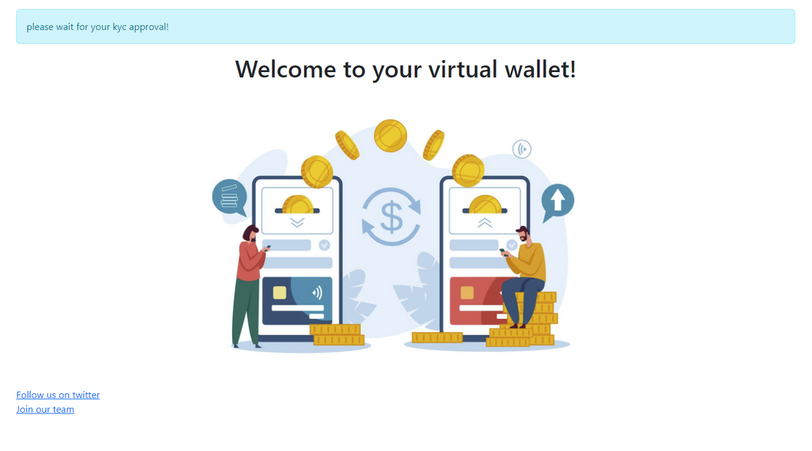
Wait for approval
BACK TO FLOWCHART

Slide 14
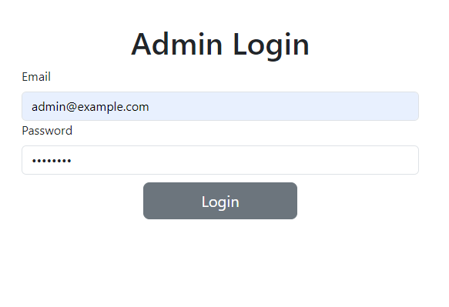
Admin Login
BACK TO FLOWCHART

Slide 15
Admin Approves KYC

Slide 16

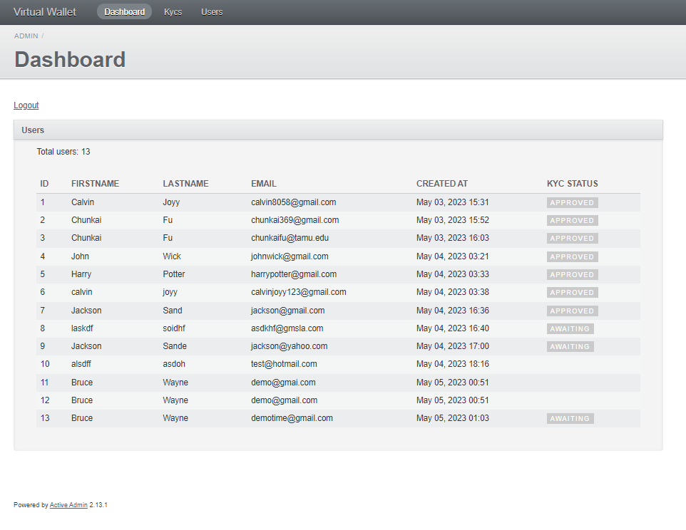
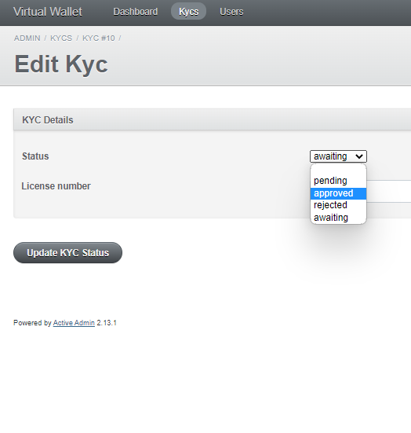
Admin Approves KYC
BACK TO FLOWCHART

Slide 17
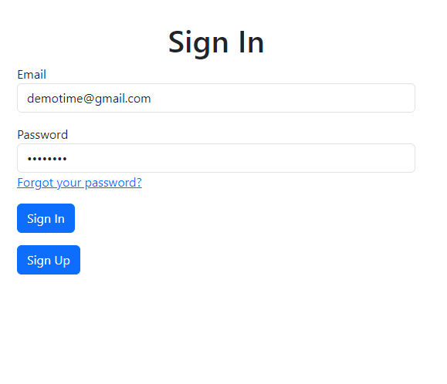
Login
BACK TO FLOWCHART

Slide 18
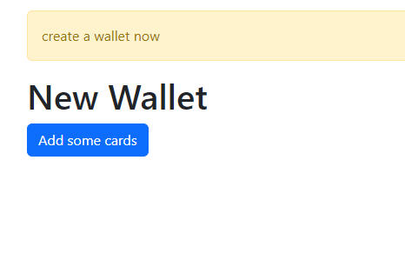
Create a wallet

Slide 19
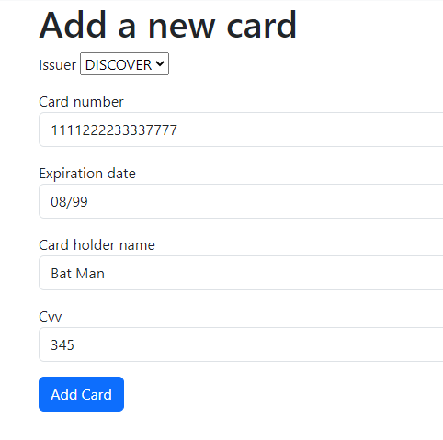
Create a wallet & add a card
BACK TO FLOWCHART

Slide 20
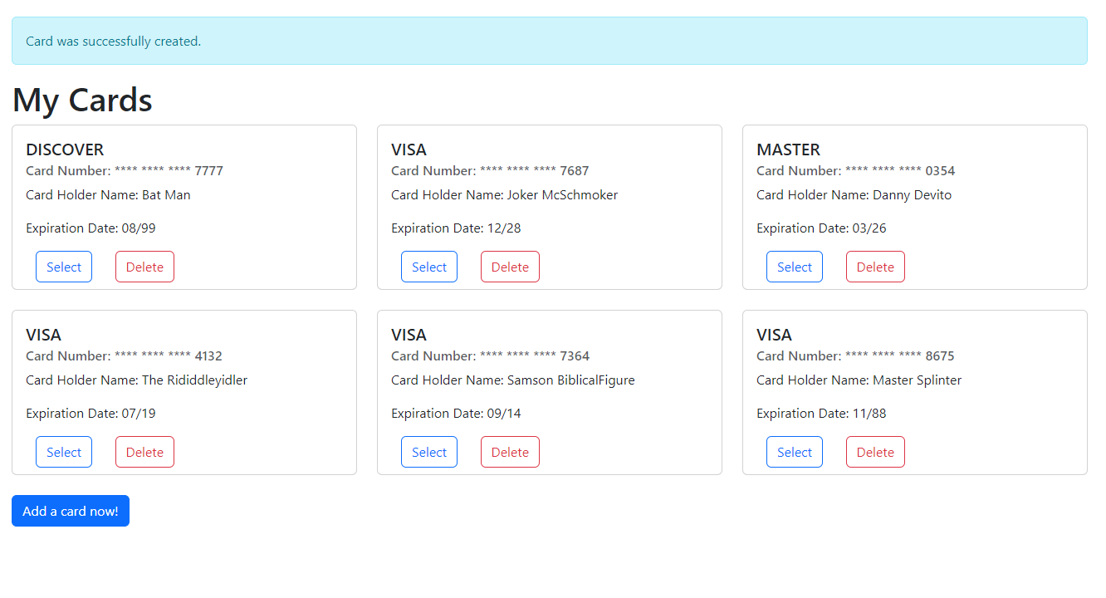
Add more cards
BACK TO FLOWCHART

Slide 21

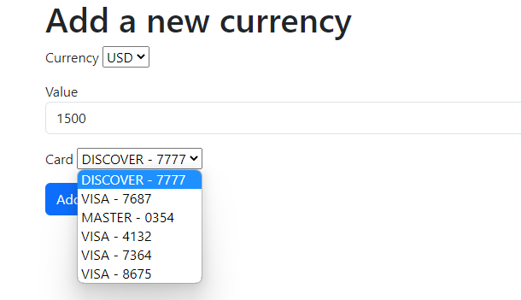
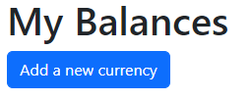
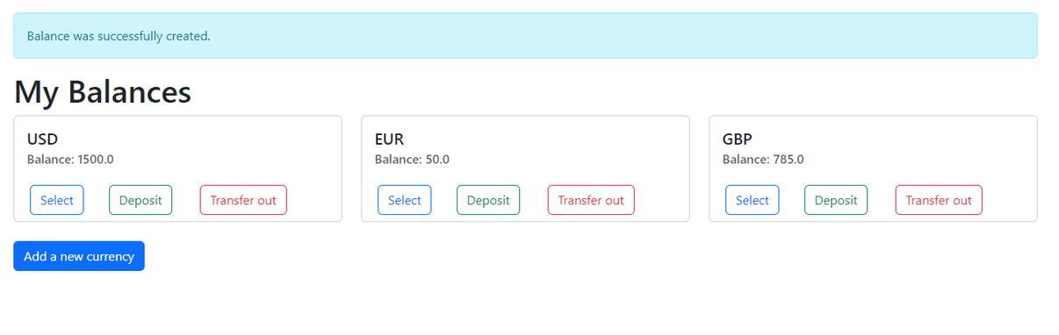
Add a balance
BACK TO FLOWCHART

Slide 22
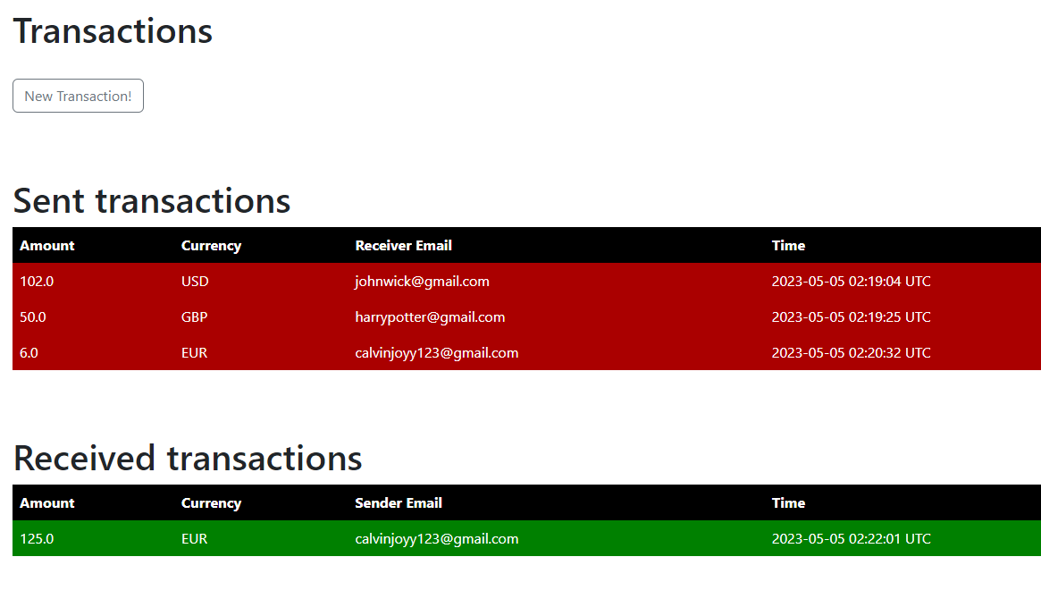
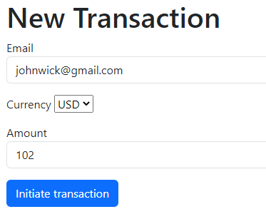
Transact with other users
BACK TO FLOWCHART

Slide 23
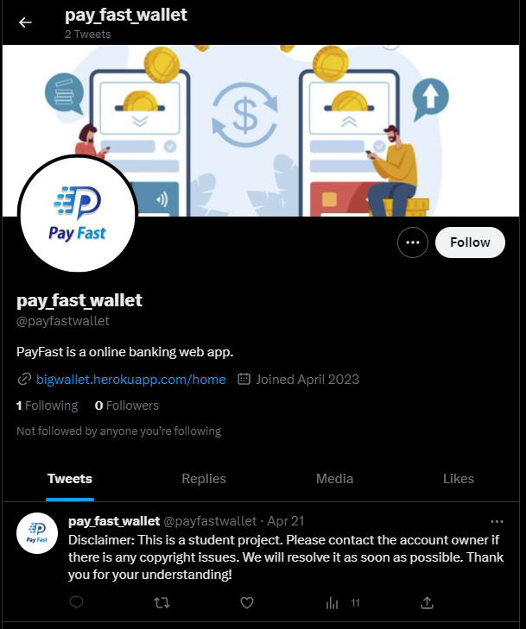
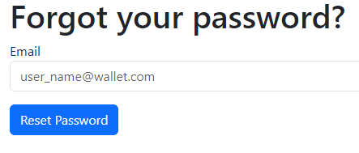
A couple extra features
Forgot password?
Follow us on Twitter!

Slide 24







Challenges and lessons
All of us had coded, none of us had truly Agile-d
The TDD/BDD learning curve compounded with the MVC learning curve
Heroku deployment
Many lessons learned in communicating with client
Had to treat client and assignment instructions as stakeholders

